Slide 1






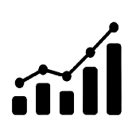




PREDICTIVE MODELING FOR VEHICLE PERFORMANCE, RELIABILITY ANALYSIS

Slide 2




Gannavarapu Lalitha Sravani
Daddanala Kaleswara Manikanta
Dhanala Rupesh Kumar
Venkata Seshadri Kaluva Kolanu

Slide 3
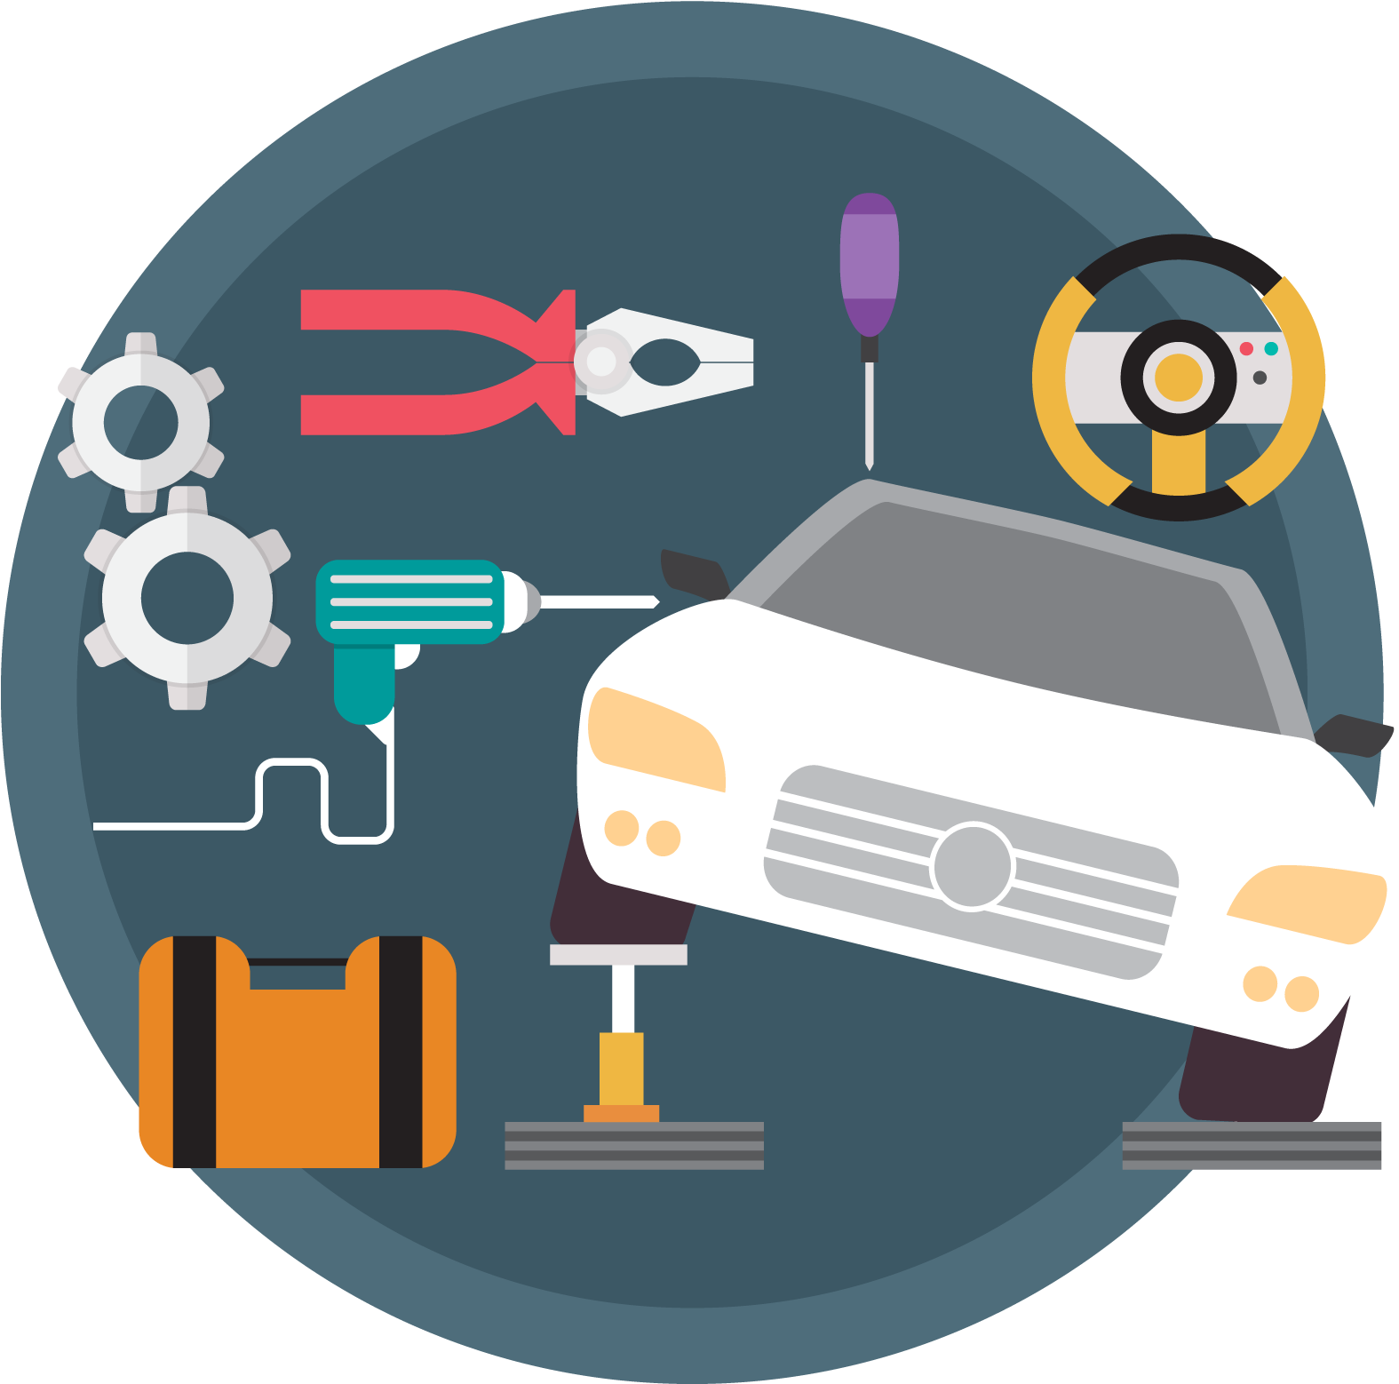





Expected Maintenance Costs & Upcoming Service Requirements?
Fuel Efficiency & Resale Value?
Technical Features & Environmental Regulations?

Slide 4
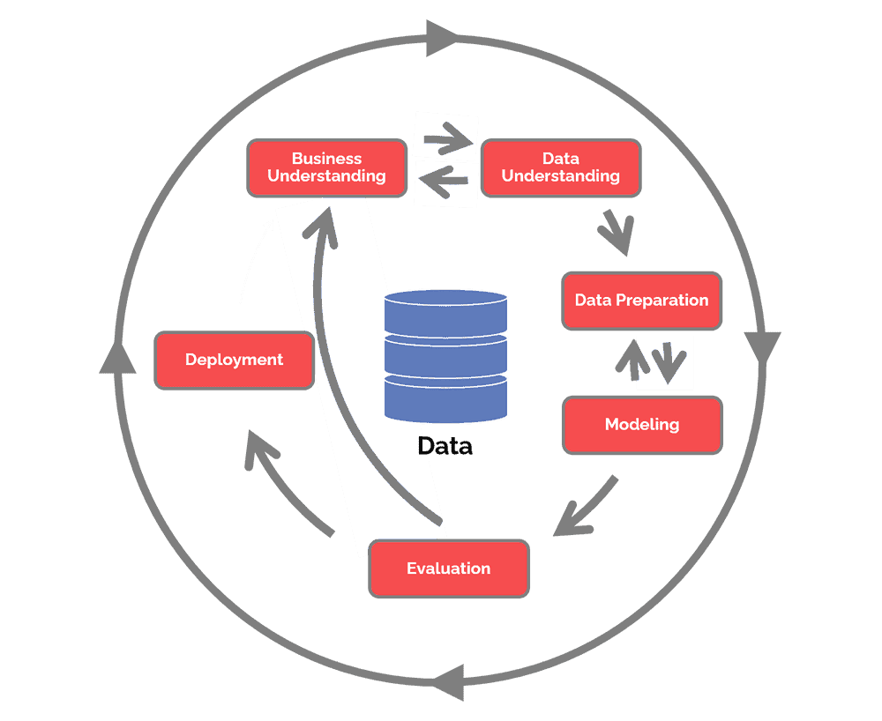
Collect initial data
Describe data
Explore data
Verify data quality
Determine business objectives
Assess situation
Determine data mining goals
Produce project plan
Select data
Clean data
Construct data
Integrate data
Format data
Plan deployment
Plan monitoring and maintenance
Produce final report
Review project
Select modeling techniques
Generate test design
Build model or Assess model

Slide 5
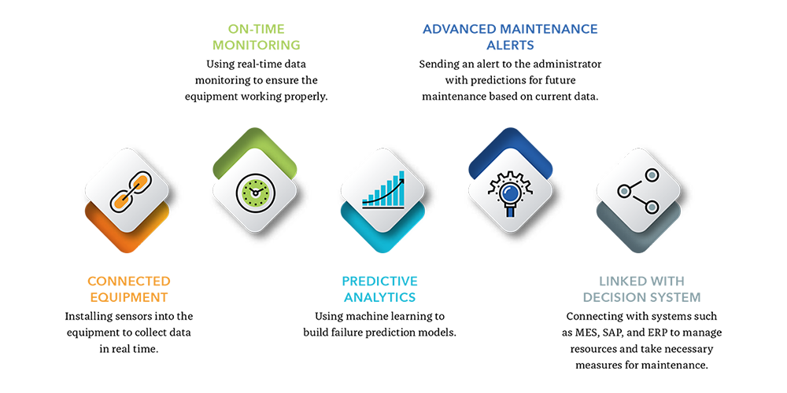

Slide 6
Predictive maintenance and predictive analytics are invaluable tools in data science, and their applications are wide-ranging, making them integral to optimizing operations and decision-making in numerous industries.
Areas Where Predictive Maintenance is Used: Manufacturing, Energy and Utilities, Aviation, Oil and Gas , Transportation , Healthcare, Facility Management.
Areas Where Predictive Analytics is Used: Marketing, Finance, Healthcare, Ecommerce, Human Resources, Weather forecasting, Sports Analytics.

Slide 7
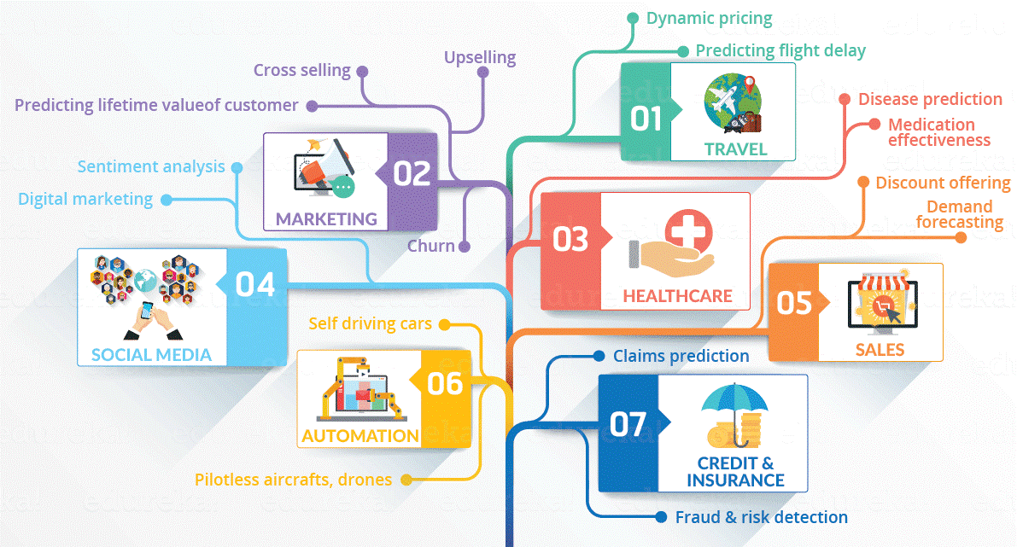


Solution for analyzing vehicle performance
& prediction of reliability
Evaluation methods for analyzing vehicle performance & reliability
Advanced Data Analysis Techniques:
Utilize statistical models and machine learning algorithms to analyze market trends
Accuracy matrices:
Evaluate the accuracy of predictions compared to actual values
Risk assessment:
Assess the potential risks and uncertainties in the analysis
Diversify Data Sources:
Gather data from multiple reliable sources to improve accuracy & reduce bias
Model robustness:
Check the stability and reliability of the models
Monitor Regulatory Developments:
Stay updated on regulatory changes and adapt analysis accordingly
Back testing:
Test the performance of trading strategies based on historical data

Slide 8
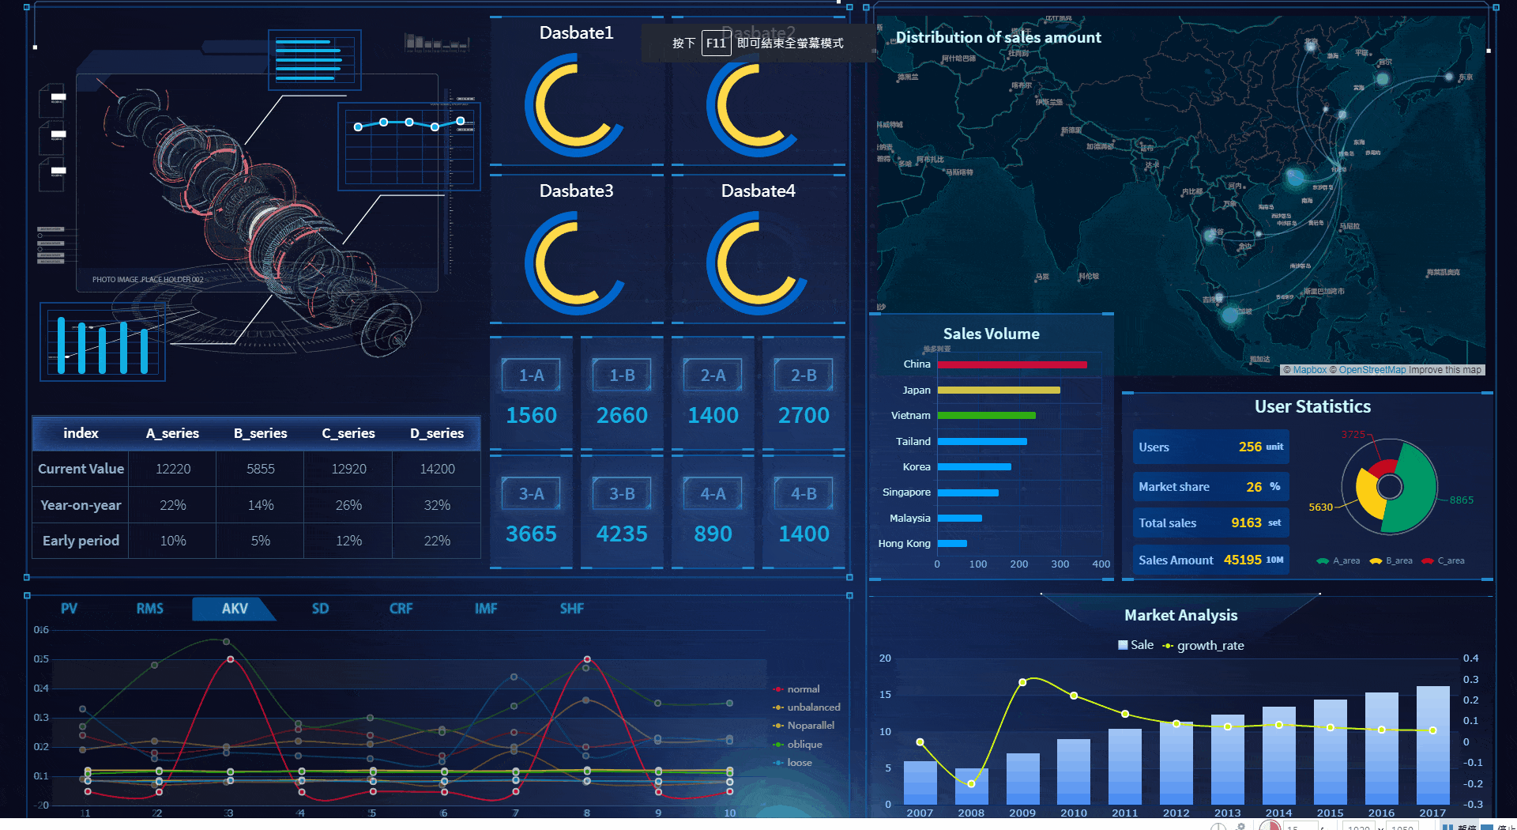
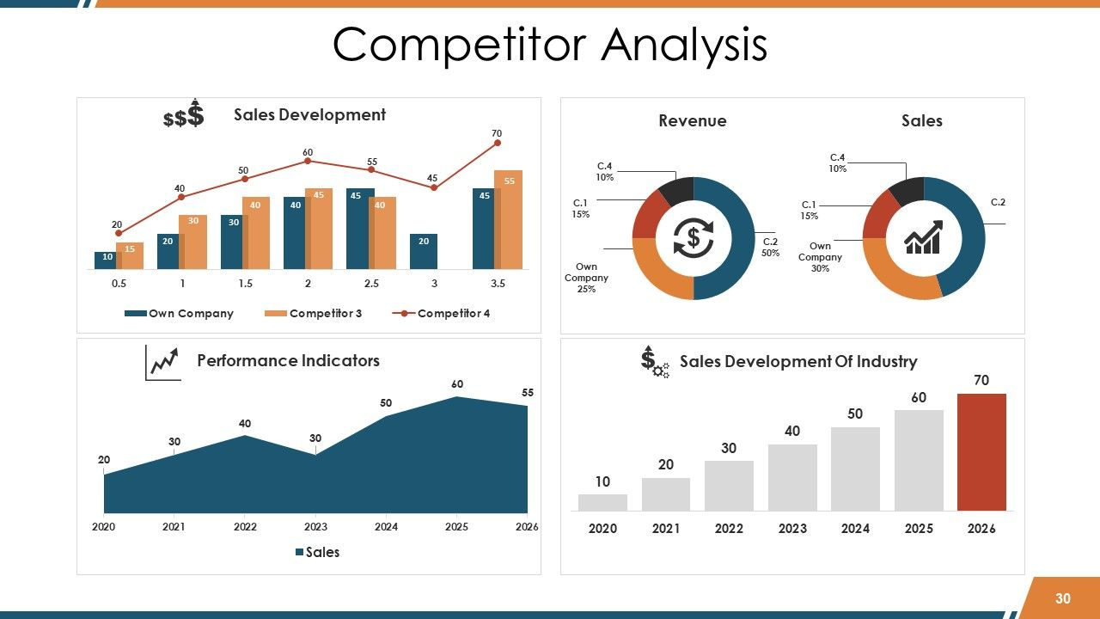


Visualizations
&
Dashboards
Reports
&
Presentations
Create interactive visualizations and dashboards for easy interpretation
Prepare comprehensive reports and presentations to communicate insights
Regular Updates
Collaboration
&
Feedback
Provide regular updates on market trends and analysis to stakeholders
Engage with stakeholders to gather feedback and improve the analysis

Slide 9
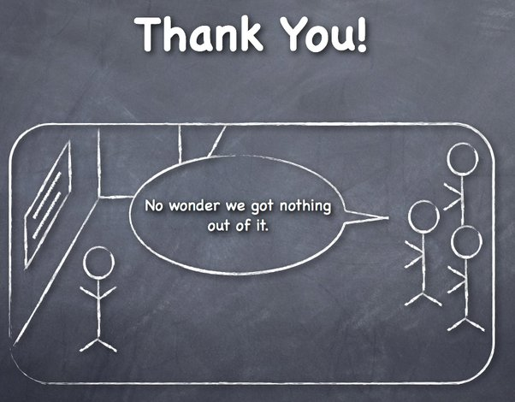

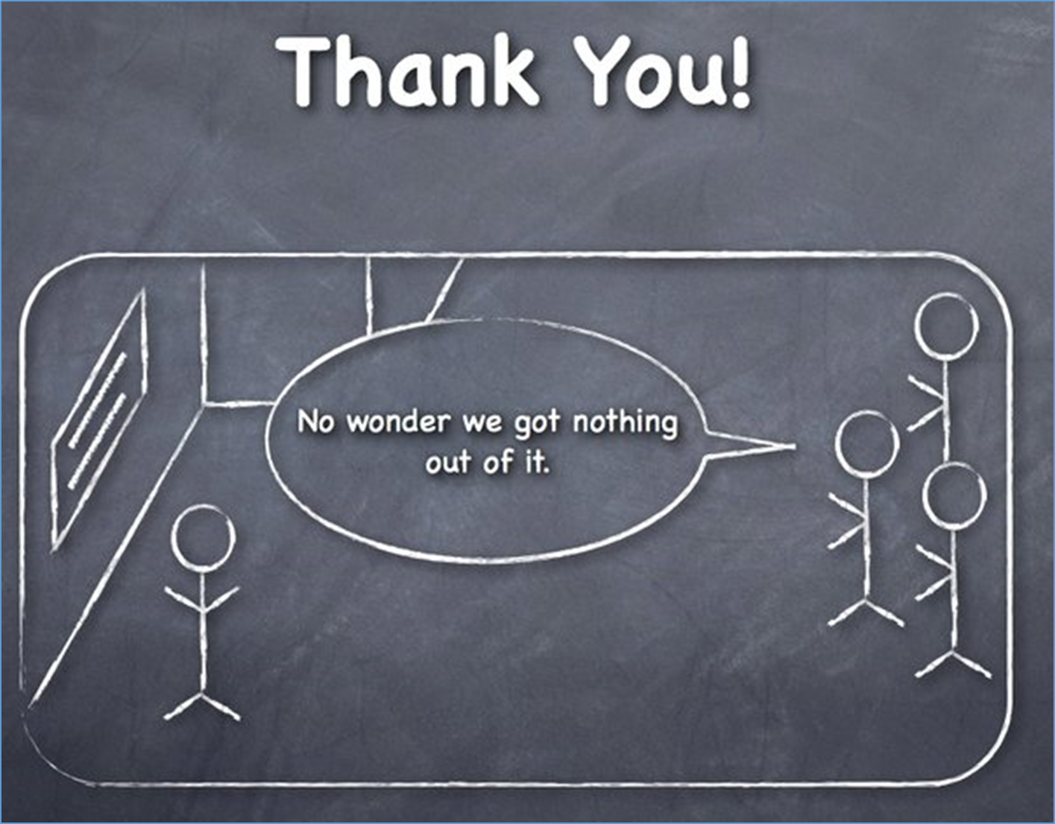

Slide 10


